Slide 1
Discovery Center
MUSEUM OF DISCOVERY AND SCIENCE
Brandon Wand
Jeffrey Schaefer
Angel Ramirez

Slide 2
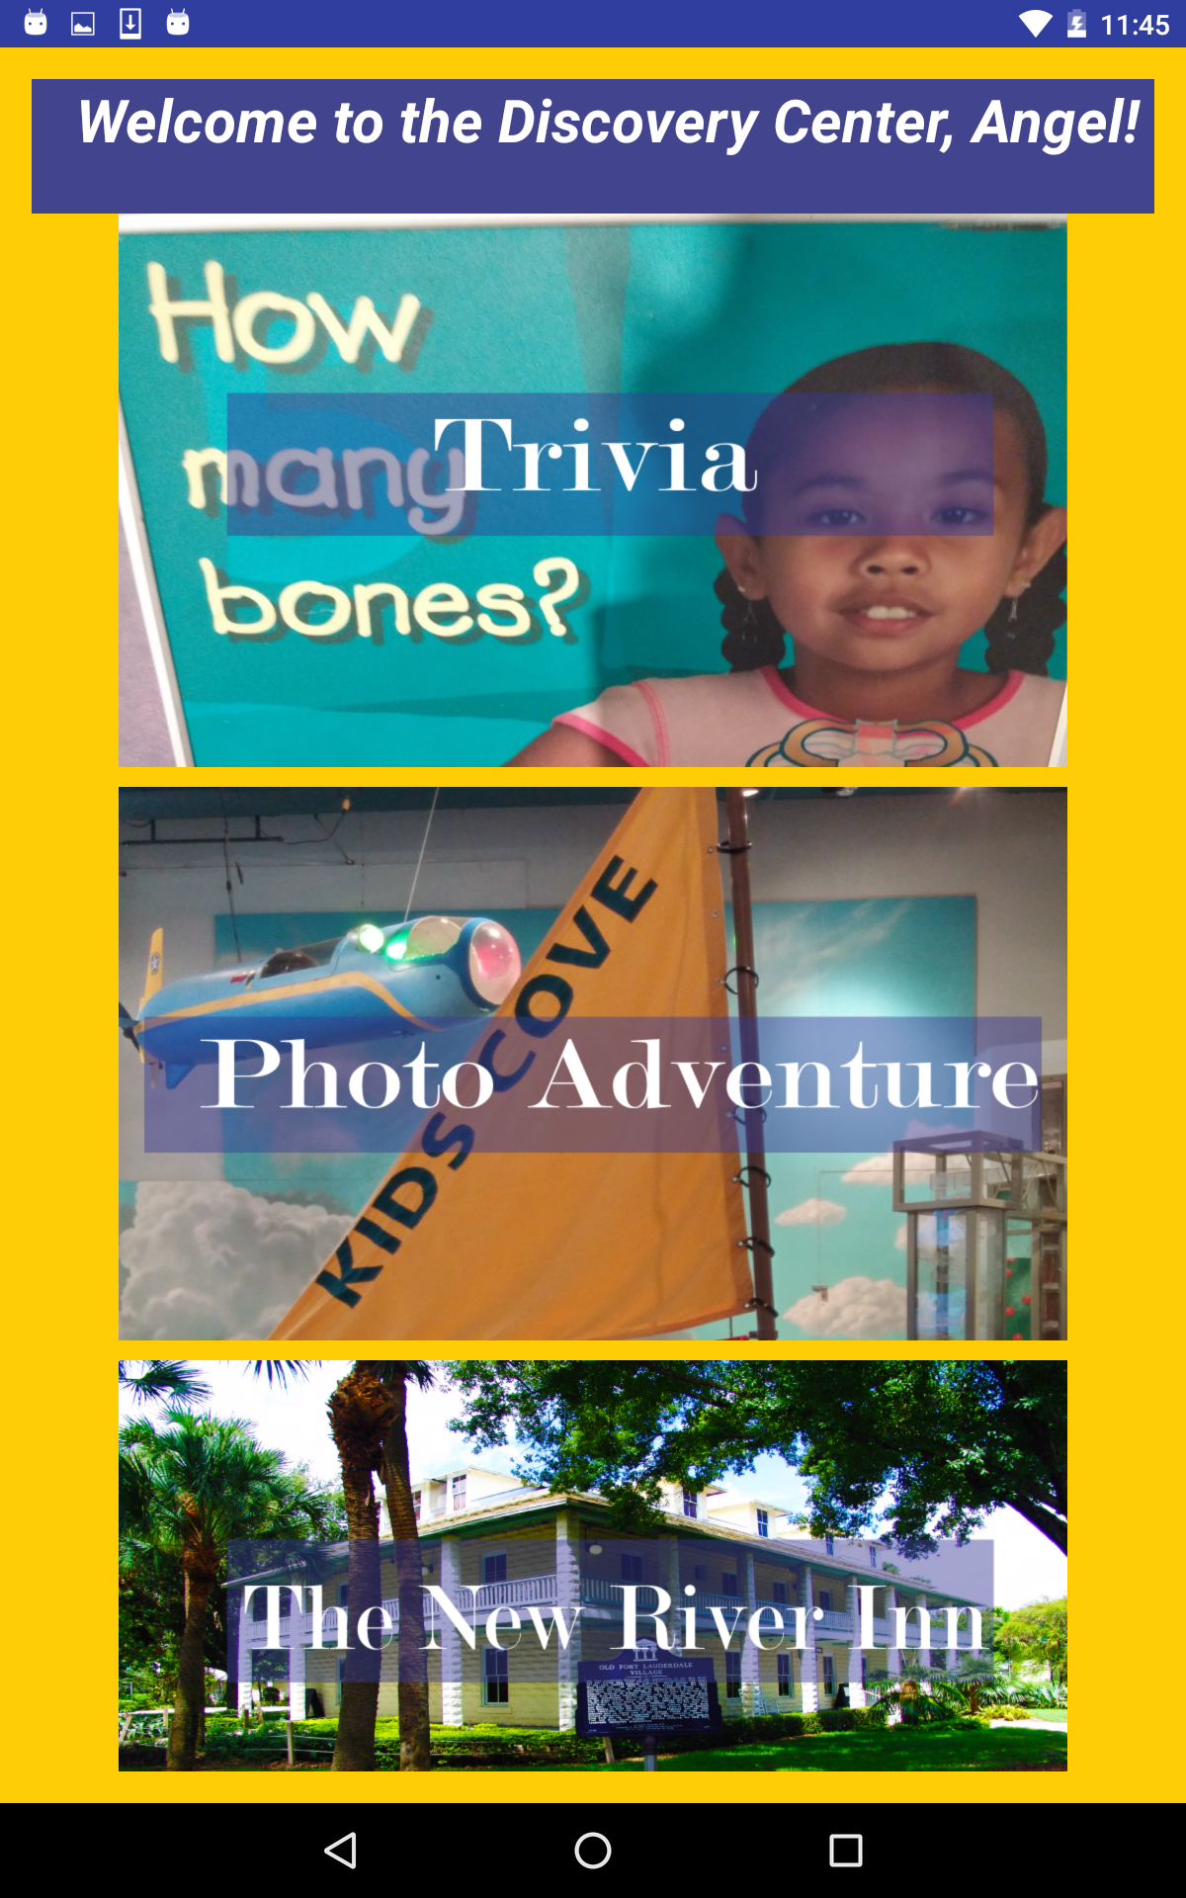
Main Activity
At the beginning of our app, users are greeted with a simple analytics page. In which the app takes our gender, age, and name. Once this is done, the user is sent to the main page, with four options they can click. The first choice being our trivia game, The second one being our Photo Adventure application, the third one being a simple information page about the New River Inn, and lastly the fourth one being the About page for our app.

Slide 3
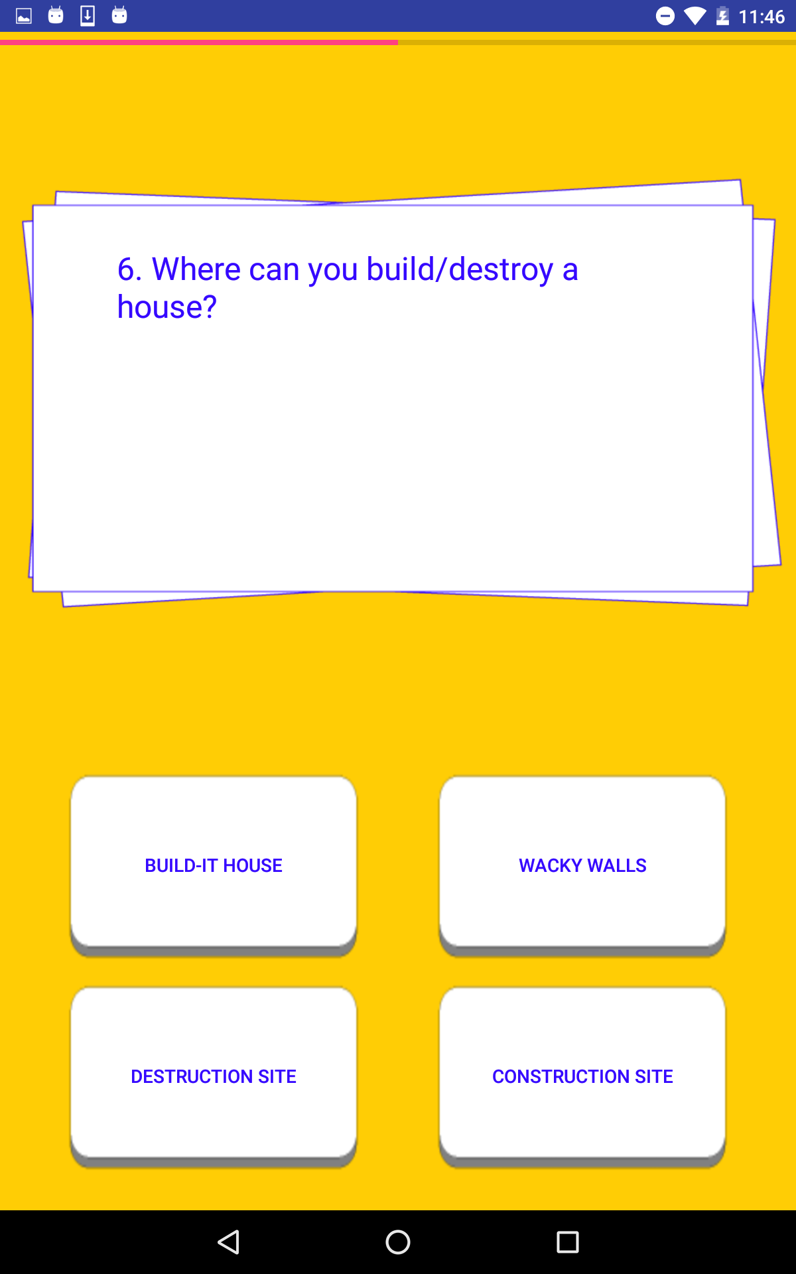
Trivia Game
This is one of our small games implemented for the user’s experience. While it is quite self explanatory, the app runs a simple test, complete with button animations and incorrect/correct images to immerse the user. The answers shuffle each time you take the test, and at the end, the app gives the user his score based on how many he got on his first try.

Slide 4
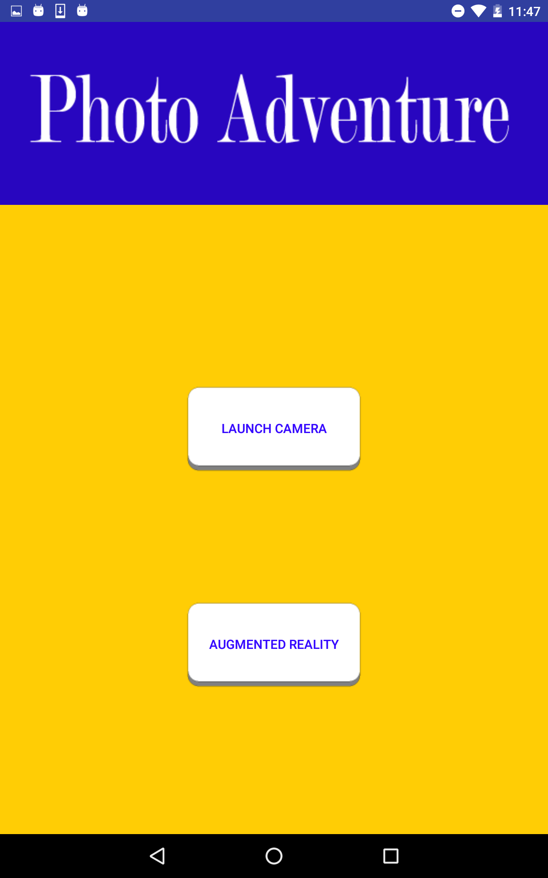
Photo Adventure
With this part of our app, users can take pictures and draw over them with various brushes, and afterwards they can save the image. The other option puts the user in the camera, and when they have the camera see a certain image, a three dimensional airplane will appear right out of it. This is our implementation of augmented reality.

Slide 5
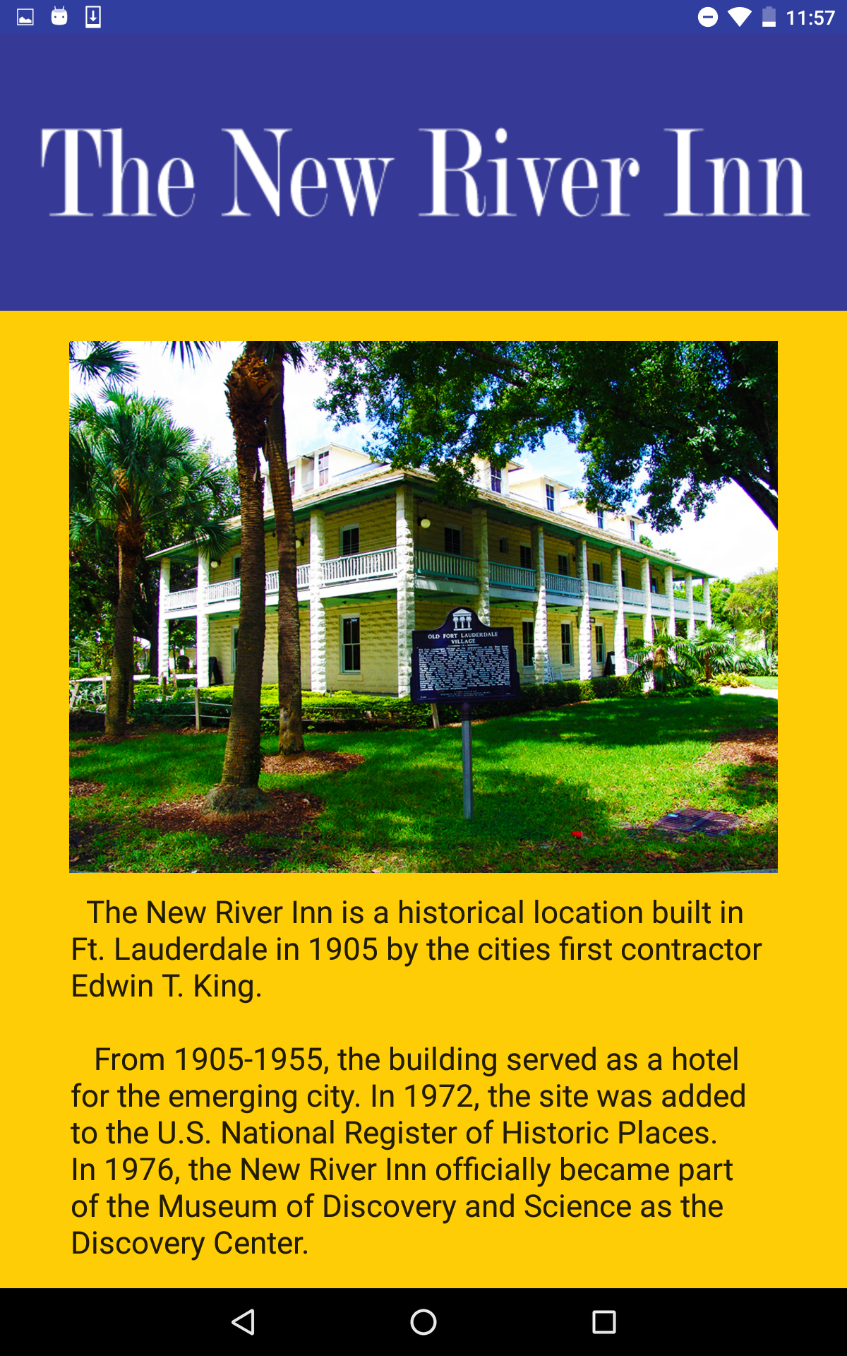
The New River Inn
This is an informational page for our adult user base, it has basic information about our center and it’s history.

Slide 6
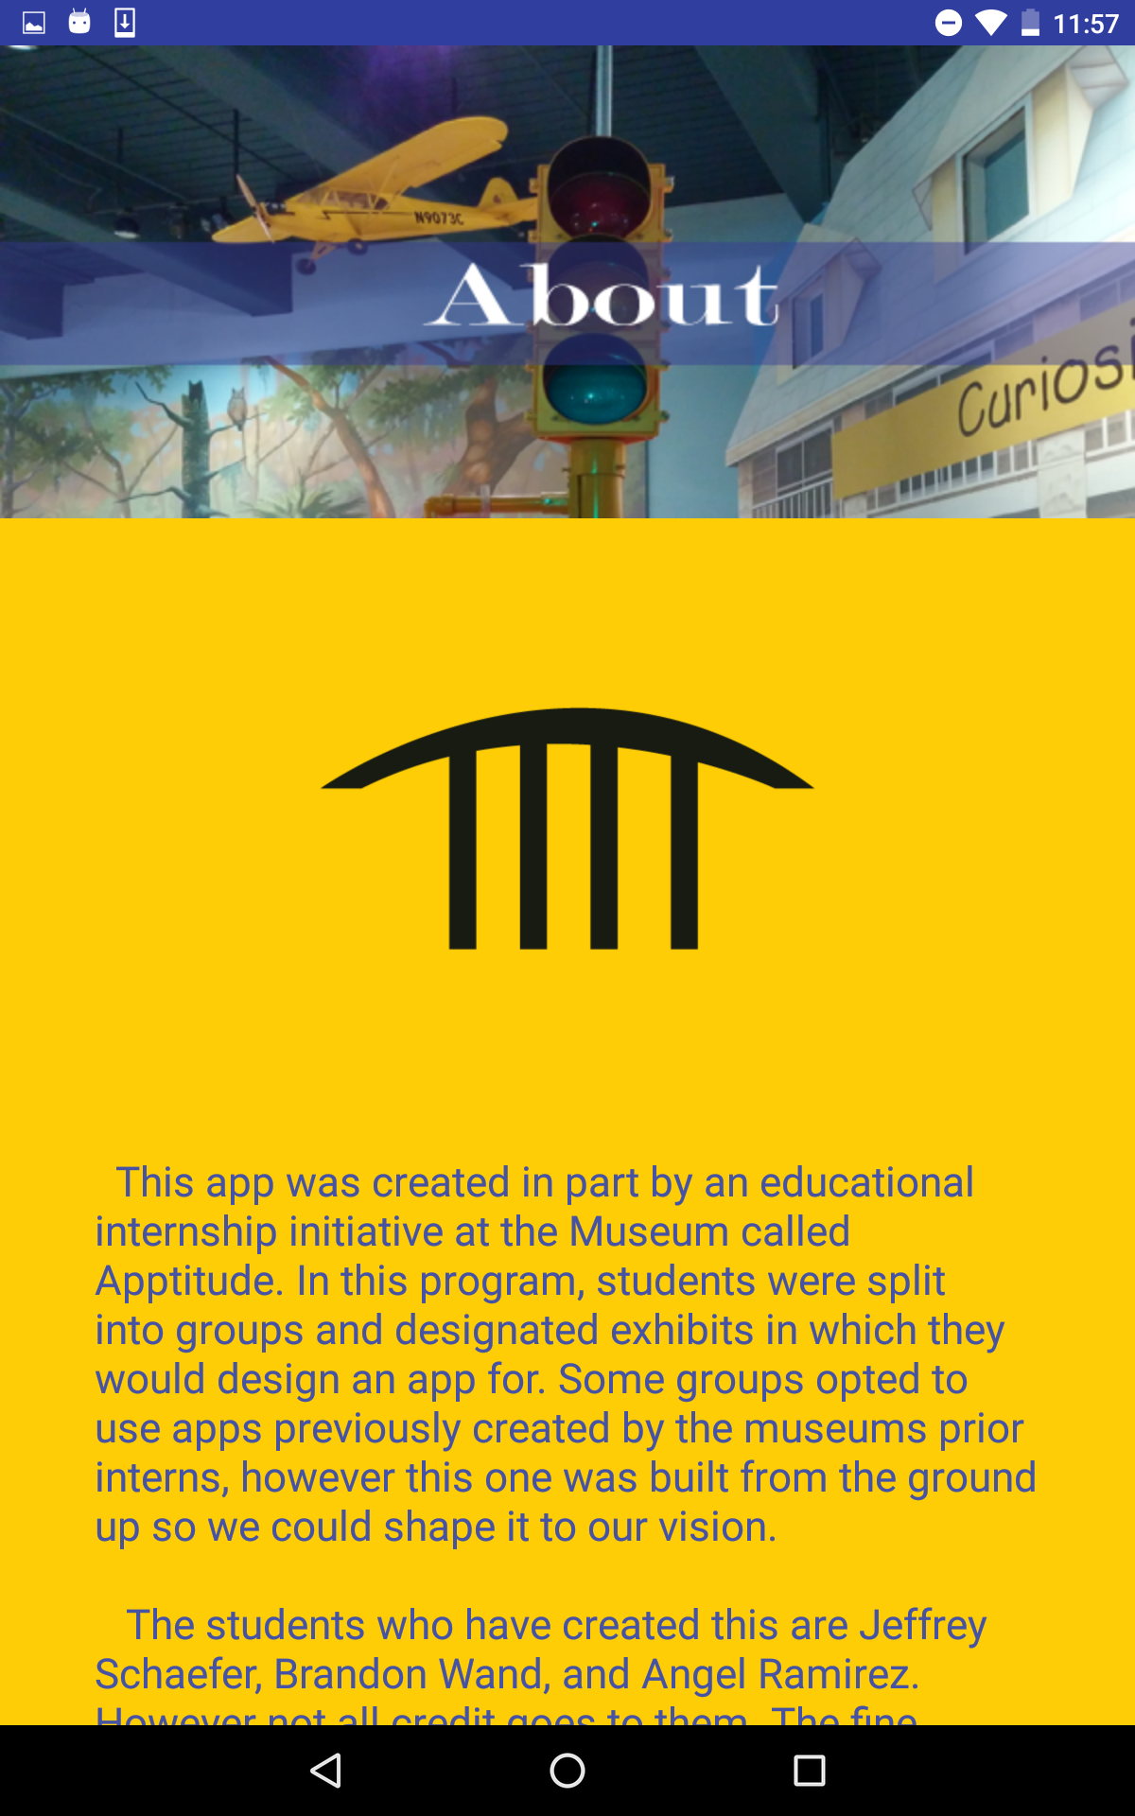
About
Basically, this is our credits page, which gives the user basic information about our app and what went into it during it’s development.

